Slide 1
Algebra Tiles
Notes:
Teachers will watch video and use ready made cornell notes to add to

Slide 2
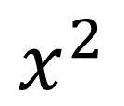
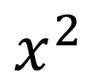
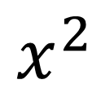



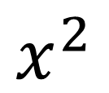

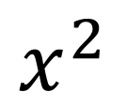
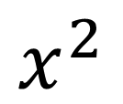
Adding Polynomials
$$\left({2x}^{2}+5x−1\right)$$
$$+ (x^{2}−2x+3)$$
$$=$$
$$3x^{2}+3x+2$$
$$x^{2}$$
-1
$$x^{2}$$
$$x^{2}$$
$$x^{2}$$
$$x^{2}$$
x
x
x
x
x
1
1
$$x^{2}$$
-x
-x
x
x
x
1
1
1

Slide 3
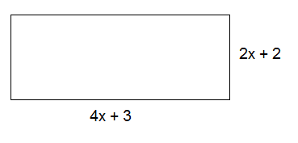






Adding Polynomials
(Find the Perimeter)
$$x^{2}−1$$
$${3x}^{2}+8x+2$$
$$x^{2}−1$$
$${4x}^{2}−2x+3$$
$$8x+2$$

Slide 4
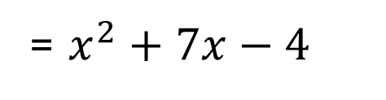
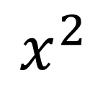

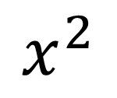
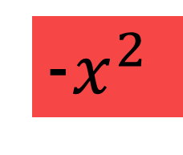



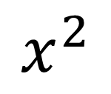
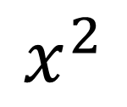
Subtracting Polynomials
$$\left({2x}^{2}+5x−1\right)$$
$$(x^{2}−2x+3)$$
= $x^{2}+7x−4$
$$−$$
$$+ ({−x}^{2}+2x−3)$$
-1
$$x^{2}$$
$$x^{2}$$
x
x
x
x
x
$$x^{2}$$
x
x
x
x
x
x
x
-1
1
-1
-1
-$x^{2}$
$$x^{2}$$
-x
-x
x
x
1
-1
-1
-1
1
-1

Slide 5
Subtracting Polynomials
You Try!
$$({2x}^{2}+3x−5)−(3x^{2}+4x−9)$$

Slide 6

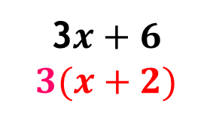

Factoring out the GCF
3$x+6$
x
x
x
1
1
1
1
1
1
X + 1+ 1
Graphic Organizer
x
1
1
3$x+6$
$$3(x+2)$$
 | 3x | +6
X + 2
x
1
+1
+1
x
1
1
1
1
1
x
3
x
x
1
1
1
x
1
1
x
+6
1
x
x
1
1
1
1
3 groups of x+2
3$x+6$
$$3(x+2)$$
Notes:
Have teachers draw even groups

Slide 7

Factoring out the GCF
You Try!
$$2x−8$$
Notes:
Teachers must understand algebra tiles show the concept of how many duplications can be made using the most available tiles in each group

Slide 8
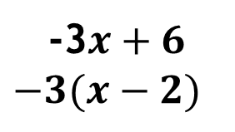
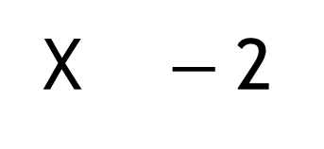

Factoring out the GCF
-3$x+6$
-x
-x
-x
1
1
1
1
1
1
x - 2
Graphic Organizer
x
-1
-1
 | -3x | +6
-x
-1
X $−$2
-1
x
1
-1
1
-3
-x
-x
-1
x
1
1
-1
-1
-3
-x
-x
-1
-1
1
x
1
-1
-x
-3$x+6$
$$−3(x−2)$$
Notes:
Gives your kids the opportunity to do something different
You would be surprised how many of your students will engage because it’s different and it doesn’t feel like math

Slide 9
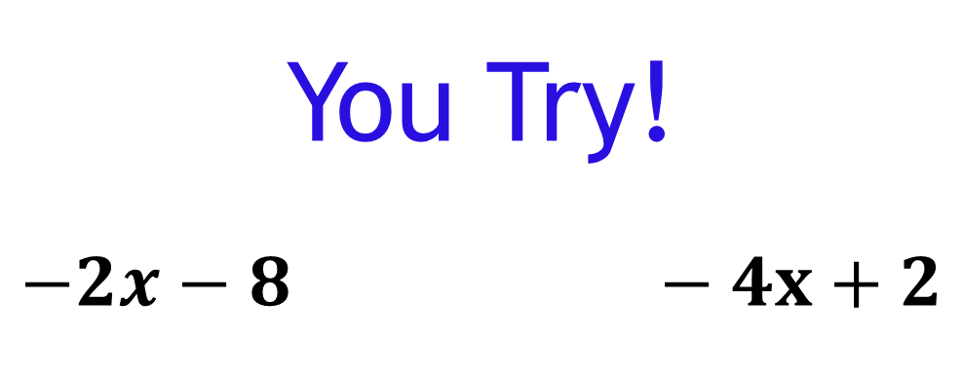
Factoring out the GCF
You Try!
$$−2x−8 −4x+2$$
Notes:
Teachers must understand algebra tiles show the concept of how many duplications can be made using the most available tiles in each group

Slide 10

Factoring out the GCF
$$4x^{2}−2x$$
$$x^{2}$$
$$x^{2}$$
$$x^{2}$$
$$x^{2}$$
-x
-x

Slide 11
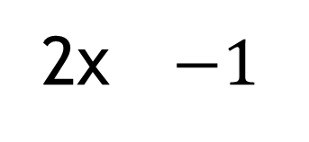
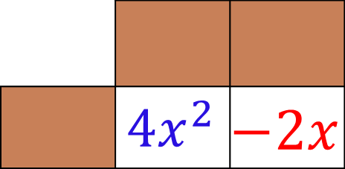
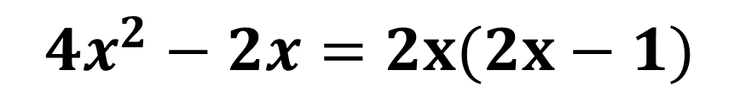
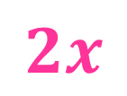

Factoring out the GCF
$$2x−1$$
X + X - 1
x
x
-1
Graphic Organizer
$$x^{2}$$
$$x^{2}$$
-x
 | $${ 4x}^{2}$$ | $$−2x$$
x
2x $−1$
x
$$2x$$
2x
-x
-x
x
$$x^{2}$$
$$x^{2}$$
-x
+ x
$$4x^{2}−2x=2x(2x−1)$$

Slide 12

Factoring out the GCF
3$x^{2}−6x$
$$x^{2}$$
$$x^{2}$$
$$x^{2}$$
-x
-x
-x
-x
-x
-x

Slide 13

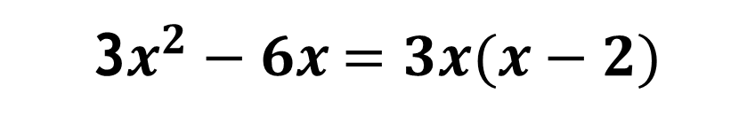
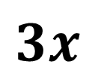
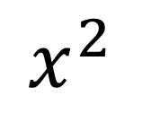
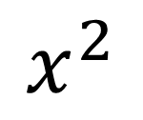
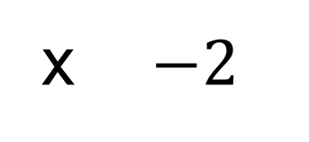
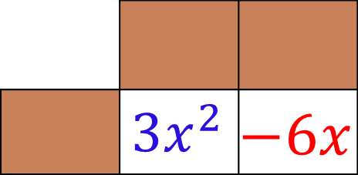
Factoring out the GCF
$$x−2$$
x
-1
-1
$$x^{2}$$
-x
-x
Graphic Organizer
x
 | $${ 3x}^{2}$$ | $$−6x$$
x $−2$
$$3x$$
+x
$$x^{2}$$
-x
-x
3x
+x
$$x^{2}$$
-x
-x
3$x^{2}−6x$$=3x(x−2)$

Slide 14
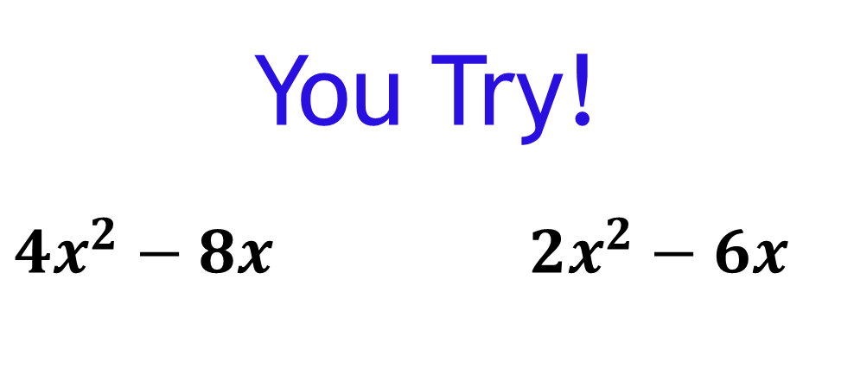
Factoring out the GCF
You Try!
$4x^{2}−8x$$2x^{2}−6x$

Slide 15
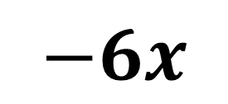

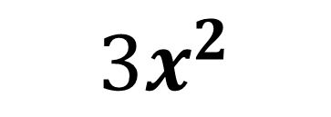

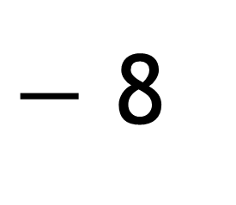
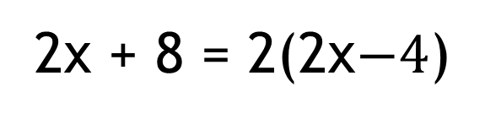
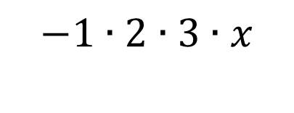




Factoring out the GCF
Graphic Organizer
x
$$−4$$
2
2x
$−$ 8
2x + 8 = 2(2x$−4$)
$$2∙x$$
$$−1∙2∙2∙2$$
x
$$−2$$
3x
$$3x^{2}$$
$$−6x$$
$${3x}^{2}−6x=3x(x−2)$$
$$3∙x∙x$$
$$−1∙2∙3∙x$$

Slide 16
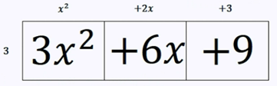
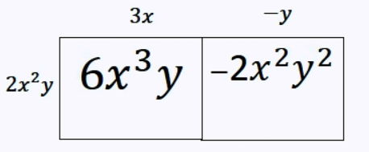
Factoring out the GCF

Slide 17


Factoring out the GCF

Slide 18
Multiplying Polynomials

Slide 19
Multiplying Polynomials
Graphic Organizer
Algebra Tiles or Area Model
(x + 1)(x + 2)
 | x² | + 2x
 | + x | + 2
x
+ 2
x
+1
+1
x
x²
x
x
x² + 2x + x + 2
x
x²
x
x
x² + 3x + 2
+ 1
x
x
1
1
(x + 1)(x + 2)
Multiplying Binomials
+1
x² + 3x + 2
Mnemonic Device: FOIL
F
+O
+I
+L
(x + 1)(x + 2)
x² + 2x + x + 2
x² + 3x + 2
Notes:
Mnemonic devices a device such as a pattern of letters, ideas, or associations that assists in remembering something.
A mnemonic device is a memory aid and an acronym is a mnemonic technique.

Slide 20
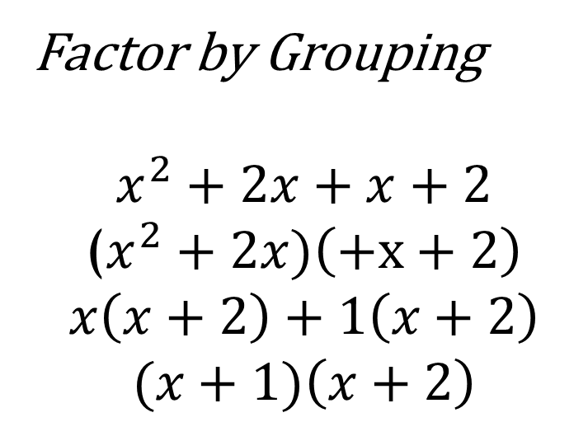
Checking your work
Factor by Grouping
$$x^{2}+2x+x+2$$
($x^{2}+2x)\left(+x+2\right)$
$$x\left(x+2\right)+1\left(x+2\right)$$
$$(x+1)\left(x+2\right)$$

Slide 21
Multiplying Polynomials
Algebra Tiles or Area Model
Graphic Organizer
(x + 2)( x + 3)
 | x² | + 2x
 | + 3x | + 6
x
+ 2
x
+1
+1
x
x
x
x²
x
x
x
x²
x
+ 3
x
x
x
+1
1
1
x
x
+1
1
1
x
x² + 5x + 6
+1
1
1
x² + 3x + 2x + 6
x² + 5x + 6
Notes:
Algebra tiles make a rectangle…opposite sides are congruent

Slide 22
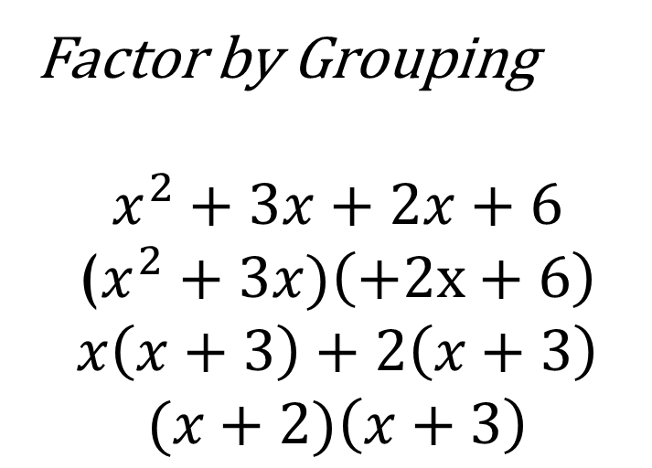
Checking your work
Factor by Grouping
$$x^{2}+3x+2x+6$$
($x^{2}+3x)\left(+2x+6\right)$
$$x\left(x+3\right)+2\left(x+3\right)$$
$$(x+2)\left(x+3\right)$$

Slide 23
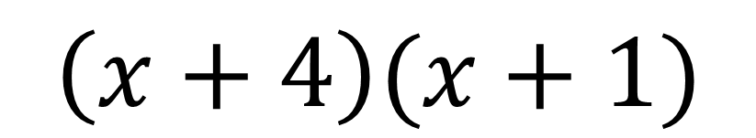
Multiplying Polynomials
You Try!
$$\left(x+4\right)(x+1)$$

Slide 24
Multiplying Polynomials
Algebra Tiles or Area Model
Graphic Organizer
(x – 3)(x + 1)
 | x² | +x
 | -3x | -3
x
+ 1
x
+1
x
x²
x
x²
x
x
-x
- 3
x
-x
-x
-1
-x
-1
-1
-x
-1
x² – 2x – 3
-1
-x
-1
x² – 3x + x − 3
x² – 2x – 3

Slide 25
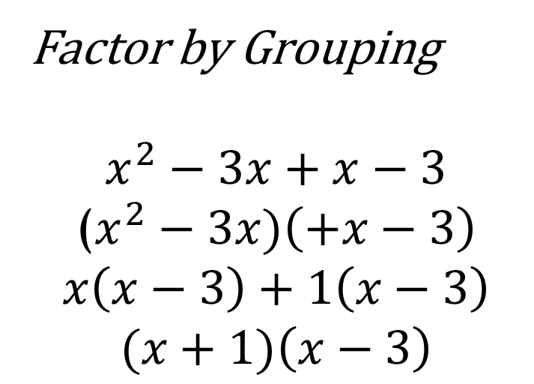
Checking your work
Factor by Grouping
$$x^{2}−3x+x−3$$
($x^{2}−3x)\left(+x−3\right)$
$$x\left(x−3\right)+1\left(x−3\right)$$
$$(x+1)\left(x−3\right)$$

Slide 26


Multiplying Polynomials
You Try!
$$\left(x−4\right)(x+1)$$
$$\left(x+4\right)(x−1)$$

Slide 27
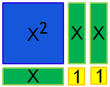
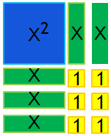
Algebra Tiles Make a Rectangle
x + 2
x
+
1
x
+
1
x + 2
x
+
3
x
+
3
x + 2
x + 2

Slide 28
Multiplying Polynomials
Algebra Tiles or Area Model
Graphic Organizer
(x – 3)(x – 3)
 | x² | -3x
 | -3x | -9
x
- 3
x
-1
-1
-1
x
x²
-x
-x
-x
x²
-x
-x
-x
x
-x
- 3
x
-x
-x
-x
-1
1
1
1
-x
1
1
1
x² – 6x + 9
-1
-x
1
1
1
-1
x² – 6x + 9
This trinomial is also a Perfect Square.
By definition, a square has all sides equal.
(x – 3)²

Slide 29


Multiplying Polynomials
Draw the algebra tiles
You Try!
$$\left(x−4\right)(x−1)$$
$$\left(x−3\right)(x−2)$$

Slide 30
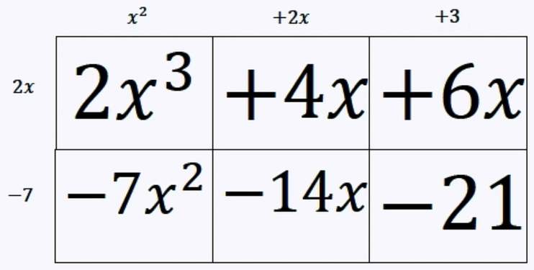


Multiplying Polynomials
Notes:
Trinomials must and terms with exponents higher than 3 must be done using the graphic organizer not algebra tiles.

Slide 31
Factoring Polynomials

Slide 32
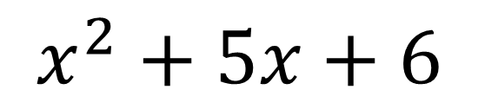
Factoring Polynomials
$$x^{2}+5x+6$$
1
1
x²
x
x
x
x
x
1
1
1
1
Now arrange them to make a rectangle

Slide 33


Factoring Polynomials
Graphic Organizer
x + 2
 | x² | + 2x
 | + 3x | + 6
x
+2
x
+1
+1
x
+
3
x
x
x
x²
x
x
x
x²
x
+3
x
x
x
+1
1
1
x
x
+1
1
1
x
+1
1
1
$$(x+2)(x+3)$$
$$(x+2)(x+3)$$

Slide 34
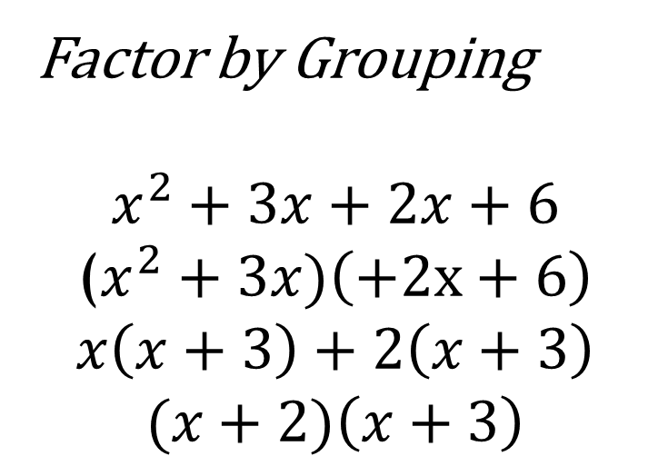
Alternate Route
 | x² | + 2x
 | + 3x | + 6
?
?
?
?
Factor by Grouping
$$x^{2}+3x+2x+6$$
($x^{2}+3x)\left(+2x+6\right)$
$$x\left(x+3\right)+2\left(x+3\right)$$
$$(x+2)\left(x+3\right)$$

Slide 35


Factoring Polynomials
You Try!
$$x^{2}+6x+8$$
$$(x+2)(x+4)$$

Slide 36
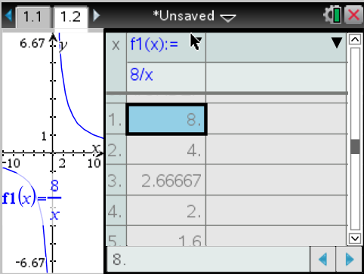
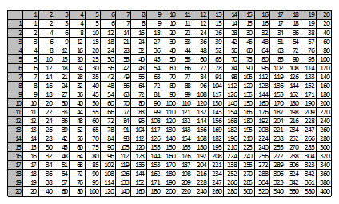





$$x^{2}+6x+8$$
$$x^{2}$$
$$?x$$
$$?x$$
$$+8$$

Slide 37
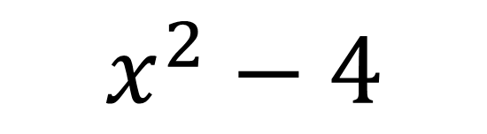
Factoring Polynomials
$$x^{2}−4$$
-1
-1
x²
-1
-1
Now arrange them to make a square

Slide 38

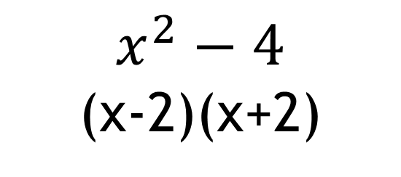
Factoring Polynomials
$$x^{2}−4$$
Remember there were
no middle terms …
x²
-x
-x
x
x
-1
-1
Use zero pairs!
-1
-1
4 empty spaces = 2 zero pairs
x - 2
Graphic Organizer
x
-1
-1
 | x² | -2x
 | +2x | -4
-x
x
-2
x
-x
x
$$x^{2}−4$$
(x-2)(x+2)
x
+
2
x²
-x
-x
x
x
x²
x
x
-1
-1
x
+1
x
x
+2
x
x
+1
-1
-1

Slide 39
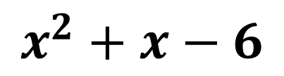
Factoring Polynomials
$$x^{2}+x−6$$
Now try to arrange them to make a rectangle
-1
-1
x²
x
-1
-1
-1
-1
x²
x²
x
x²
x
x
-1
-1
-1
-1
-1
-1
-1
-1
-1
-1
-1
-1
-1
-1
-1
-1
-1
-1
When you have an even number of x’s missing use zero pairs

Slide 40
x
-x
-x
x
-x
-x
x
-x
-x
x
-x
x
x
x
x²
-x
-x
x²
x
x
x
x²
x
x
x
x
-x
-x
x
-1
-x
-1
-1
-1
-1
-x
-x
-1
-1
-1
-1
-1
-1
-1
-1
-1
-1
-1
x
x
-1
-1

Slide 41

Factoring Polynomials
Algebra Tiles or Area Model
Graphic Organizer
$$x^{2}+x−6$$
 | x² | +3x
 | -2x | -6
x
+3
x
1
1
1
x
x²
x
x
x
x²
x
x
x
x
-x
-2
x
-x
-x
1
1
1
-1
-x
1
1
1
-1
(x – 2)(x + 3)

Slide 42
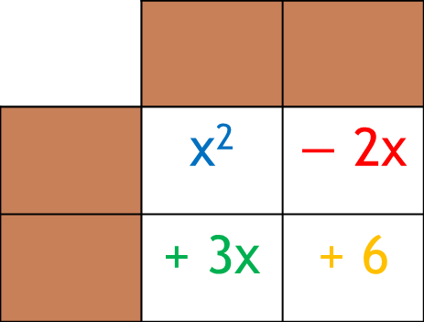

Alternate Route
 | x² | $−$ 2x
 | + 3x | + 6
?
?
?
Factor by Grouping
$$x^{2}+3x−2x−6$$
($x^{2}+3x)\left(−2x−6\right)$
$$x\left(x+3\right)−2\left(x+3\right)$$
$$(x−2)\left(x+3\right)$$
?

Slide 43





Factoring Polynomials
You Try!
$$x^{2}−9$$
$$x^{2}+2x−8$$
$$(x−2)(x+4)$$
$$(x−3)(x+3)$$
$$(x−2)(x+4)$$

Slide 44


Factoring Polynomials
$$x^{2}+3x=4$$
Now try to arrange them to make a rectangle
-1
-1
x²
x
x
x
-1
-1
x
+1
+1
+1
+1
x²
x
Not an even number of missing x’s… can’t use zero pair
x²
x
x
x
x
x
x
-1
-1
-x
-1
-1
-1
-1
x
-1
-1
-1
When you have an even number of x’s missing use zero pairs
x
x
$$(x+4)(x−1)$$

Slide 45


Factoring Polynomials
Draw the algebra tiles
You Try!
$$x^{2}−5x=6$$
$$(x−6)(x+1)$$

Slide 46

Factoring Polynomials
${ 2x}^{2}+5x=3$
$${ 2x}^{2}+5x−3=0$$
x²
x²
x
x
x
x
x
-1
-1
-1

Slide 47







Factoring Polynomials
x + 3
x
+1
+1
+1
x
+ 3
x
x²
x
x
x
2x
$${2x}^{2}$$
$$+6x$$
2x $−$ 1
X+
x²
x
x
x
-1
$$−1x$$
$$−3$$
-1
x-
-1
-1
-1
$${2x}^{2}+5x−3=0$$
($2x−1$)($x+3$)
$2x−1=0$$x+3=0$
$x=\frac{1}{2} x=−3$

Slide 48

Alternate Route
?
?
?
$${2x}^{2}$$
$$+6x$$
Factor by Grouping
$$2x^{2}+6x−1x−3$$
(${2x}^{2}+6x)\left(−1x−3\right)$
$$2x\left(x+3\right)−1\left(x+3\right)$$
$$(2x−1)\left(x+3\right)$$
?
$$−1x$$
$$−3$$

Slide 49




$${ 2x}^{2}+5x−3=0$$
$${2x}^{2}$$
$$?x$$
$$?x$$
$$−3$$

Slide 50




Factoring Polynomials
Draw the algebra tiles
You Try!
$${3x}^{2}+5x+2$$
$${3x}^{2}−5x−2$$
$$(3x+1)(x+2)$$
$$(3x+1)(x−2)$$

Slide 51
Completing the Square

Slide 52







Completing the Square
$${\left(\frac{8}{2}\right)}^{2}$$
$$\left(\frac{8}{2}\right)$$
$$x^{2}+8x+ ____={(x + )}^{2}$$
$$16$$
$$4$$
$$x+4$$
Let’s make a square with
the given tiles
Now place the yellow tiles to complete the square!
x²
x
x
x
x
When the yellow tiles are put into place, $\left(\frac{8}{2}\right)$will be squared
$$x$$
+
4
8 tiles split into two groups
Since the length of each side is x+4, square it!
x²
x
x
x
x
x
x
x
x
1
1
1
1
1
1
1
1
16
Yellow tiles
x
x
x
x
1
1
1
1
1
1
1
1

Slide 53




Factoring Polynomials
Draw the algebra tiles
You Try!
$$x^{2}+6x+ ____={(x + )}^{2}$$
$$x^{2}+6x+9={(x + 3 )}^{2}$$
$$x^{2}+7x+ ____={(x + )}^{2}$$
$$x^{2}+7x+ \frac{49}{4}={(x + \frac{7}{2} )}^{2}$$

